Slide 1
Music Streaming Platform
Bisham Raj Pandey-15
Bishal Regmi-14

Slide 2
Introduction
The platform allows users to listen to music and interact with it by liking or disliking tracks.
Users can create personalized playlists from the songs they’ve liked.
Artists can upload their music and specify preview segments to showcase specific parts of their tracks.
The system includes a recommendation algorithm that tailors song suggestions based on user preferences and interactions.

Slide 3
Problem Statement
Short Attention Spans and Song Previewing Needs:
Lack of Personalized Recommendations
Limited User Interaction with Music
Difficulty in Managing Playlists

Slide 4
Objectives
Develop a user-friendly music streaming platform
Implement a customizable preview system
Build a recommendation algorithm

Slide 5
Requirement Analysis
Problems of current systems
Music recommendations are often generic and fail to adapt to user preferences.
Users struggle to find new music that matches their tastes.
Playlist creation can be tedious, with too many options and no personalized filtering.
Advantages of Proposed system
The recommendation system adapts in real-time based on user interactions.
Users can easily curate playlists from songs they have already liked.
The preview system helps users quickly decide if they enjoy a song.

Slide 6
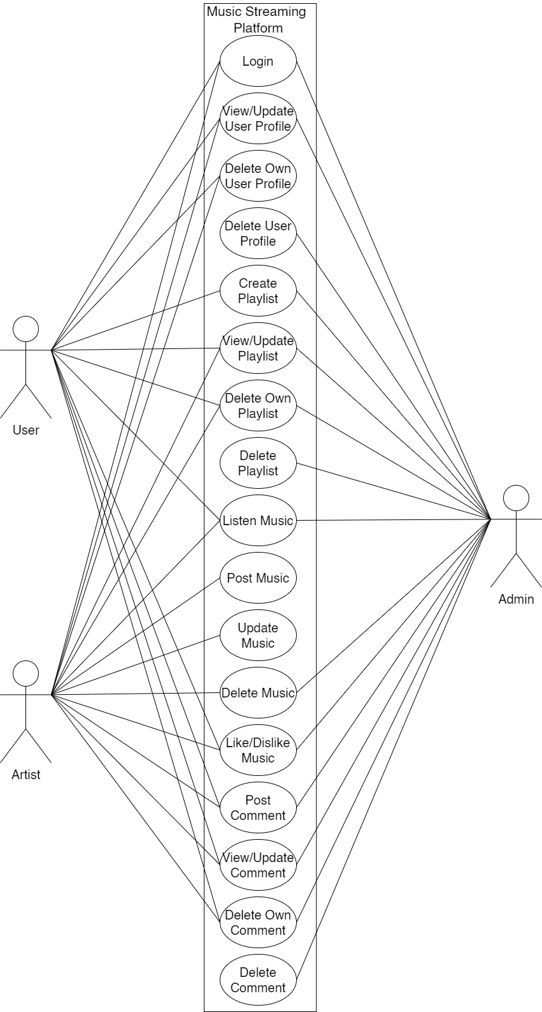
Use-Case Diagram

Slide 7
Feasibility study
Technical
The implementation of the system is adaptable to a range of current technologies and is designed to integrate with any future technologies that may be introduced.
Hardware Requirement
Dell Vostro
8 GB RAM
ii. Software Requirement
Operating System: Windows
Web Browser: IE 10 or above, Mozilla FF and above or Google Chrome
Draw.io
iii. Language used:

Slide 8
Feasibility study
Operational
The existing operational model ensures efficient throughput and quick response times.
The organization will reap significant benefits from the proposed system.
The available resources are utilized effectively to deliver a high-quality system within the set timeline.
Economic
The system offers cost-effectiveness.
The streamlined resource management will lower the overall system cost.
The advantages provided by the system will significantly outweigh its costs

Slide 9
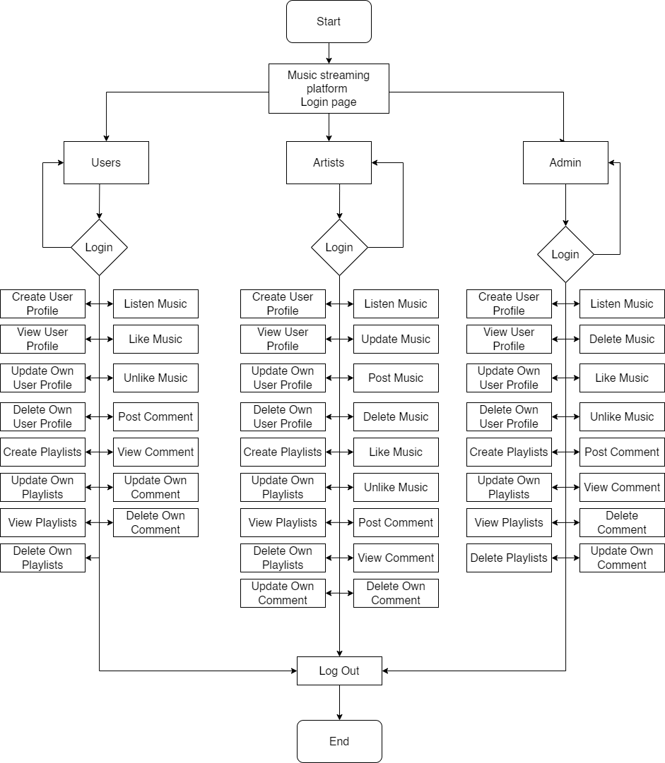
High Level Design of System

Slide 10
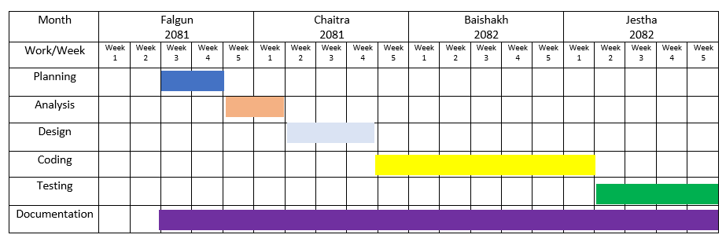
Gantt Chart

Slide 11
Expected Outcome
Improved User Experience: Users will be able to effortlessly interact with the platform, swiping through songs, and enjoying the content with minimal effort.
Responsive Interface: The platform will adapt seamlessly to various devices, ensuring smooth performance across all screen sizes.
Effective Communication: Users and artists can engage with each other through features like direct messaging and comments, fostering better interaction.

Slide 12
References

